Slide 1
ENTREPRENEURSHIP
FOR
COMPUTER SCIENTISTS

Slide 2
Course Objectives
Do you dream of running your own business in the computer science industry?
This computer science entrepreneurship course will provide knowledge and important skills to create and lead start-ups through the concentration of entrepreneurship.
We will look at how the Covid-19 pandemic is creating challenges for the industry but is also driving innovation and change across the sector.

Slide 3
Course Objectives
Why study Computer Science Entrepreneurship?
Entrepreneurship develops new computing markets, introduces new software and hardware technologies, and creates employment. Therefore, is demanding to enhance the computer science and software engineering programs with entrepreneurship.
This course gives particular skills needed to run a technological business.

Slide 4
Course Objectives
This course will cover content specific to computer science as well as business management modules set in the context of the industry.
You will develop your knowledge in areas from understanding the concept of entrepreneurship, financial understanding to marketing and human resources, while learning how to apply this knowledge in a start-up or new business.

Slide 5
Course Objectives
By studying this course, you will gain invaluable skills, such as:
Problem-solving,
Analysis,
Communication,
Innovation,
Change management,
Risk-taking,
Management,
Financial and business acumen, and
Managing your own business.

Slide 6
Course Objectives
It will also prepare you to lead effectively in an ever-evolving sector, with the skills and confidence needed to tackle the issues the sector is facing today and into the future.
Upon successful completion of the course, you could run your own business

Slide 7
Course Topics
Weeks 1& 2
NATURE AND DEVELOPMENT OF ENTREPRENEURSHIP
Week 3
THE BUSINESS ENVIRONMENT AND ENTREPRENEURSHIP
Weeks 4 & 5
WRITING A BUSINESS PLAN

Slide 8
Course Topics Cont.
Week 5
THE ROLE OF SMALL AND MEDIUM ENTERPRISES IN ECONOMIC DEVELOPMENT
Week 6
STARTING A BUSINESS VENTURE
FORMS OF BUSINESS OWNERSHIP
Week 7
RECOGNIZING BUSINESS OPPORTUNITIES AND GENERATING IDEAS

Slide 9
Course Topics Cont.
Week 8
FEASIBILITY ANALYSIS
DEVELOPING AN EFFECTIVE BUSINESS MODEL
Week 9
ENTREPRENEURIAL RESOURCE
CREATING NEW-VENTURE TEAM
Week 10
INTELLECTUAL PROPERTY FOR BUSINESS
FINANCIAL MANAGEMENT

Slide 10
Course Topics Cont.
Week 11
MARKETING MANAGEMENT
PRODUCTION AND OPERATION MANAGEMENT
Week 12
STRATEGIES FOR FIRM GROWTH
BUYING EXITING BUSINESS VENTURE

Slide 11
Reading Materials
Buame, S.C.K. (2012) Entrepreneurship: Entrepreneurial Education, Venture Creation and SME Management. Bigmikes Publications, Accra.
Kaufmann Centre for Entrepreneurial Leadership, (2001) Planning and Growing a Venture, Fast Track), New York.
Organisation for Economic Co-Operation and Development (OECD) (2004) Entrepreneurship: A Catalyst for Urban Regeneration, ISBN: 92-64-01731-3
Welsh, Harold P. (Ed.) (2004) Entrepreneurship: The Way Ahead, Routledge, ISBN 978-0-415-32394-9
Boachie-Mensah F.O & Marfo-Yiadom, E. (2005) – Entrepreneurship and Small Business Management. Accra: Ghana Universities Press.
Other materials supplied by the lecturer as lectures progress

Slide 12
CHAPTER ONE:
NATURE AND DEVELOPMENT OF ENTREPRENEURSHIP

Slide 13
NATURE AND DEVELOPMENT OF ENTREPRENEURSHIP
The word entrepreneur is derived from the French words “entre”, meaning “between” and “prendre”, meaning “to take”.
The word was originally used to describe people who “take on the risk” between buyers and sellers or who "undertake" a task such as starting a new venture.

Slide 14
Con’t
Cantillon introduced an economic system based on classes of actors and entrepreneurs are one of the three classes.
landowners’ who are financially independent
Hirelings earned fixed incomes
Entrepreneurs set up with capital to conduct their enterprise.

Slide 15
Con’t
By the 18th century a clear cut distinction was drawn between entrepreneur and capital provider due to the outcome of industrialization
As we moved ahead to the late 19th and 20th century the entire global scenario changed

Slide 16
Con’t
There was not much difference in entrepreneurs and managers, both were often regarded as the same.
In the late 20th century according to Merriam-Webster's online dictionary, "An entrepreneur is one who organizes, manages, and assumes the risk of a business or an enterprise".

Slide 17
Exploring the Meaning of Entrepreneurship

Slide 18
Tracing the Meaning of Entrepreneurship
No single universally accepted definition of entrepreneurship
Economists, psychologists, sociologists, management scientists, have different ideas about what is “entrepreneurship” and the “entrepreneur”
The word “entrepreneur” is derived from the French root “entreprendre” meaning “to undertake” an expedition.

Slide 19
RICHARD CANTILLON, FRANCE, 1680-1734
Richard Cantillon, France (1680-1734)
Generally acknowledged as the first to use the word “entrepreneur” in a commercial sense – he coined entrepreneur (undertaker) or from the root word entreprendre.

Slide 20
Richard Cantillon (contd.)
The entrepreneur is someone who exercises business judgment in the face of uncertainty.
The entrepreneur is motivated by the potential for profit generated from engaging in the speculative activity.
The entrepreneur “buys at a certain price and sells at an uncertain price.”

Slide 21
DEFINITIONS OF ENTREPRENEURSHIP
Peter F Drucker
Entrepreneurship is the ability to create something new and different
Thomas W Zimmerer
Entrepreneurship is the application of creativity and innovation to solve problems and effort in utilizing opportunities faced by everyone and every day.

Slide 22
DEFINITIONS OF ENTREPRENEURSHIP
Ronstadt
Entrepreneurship is the dynamic process of creating incremental wealth. This wealth is created by individuals who assume the major risks in terms of equity, time and/or career commitment of providing value for some products or services

Slide 23
DEFINITIONS OF ENTREPRENEURSHIP
Hisrich & Peters
Entrepreneurship is the process of creating something different with value by devoting the necessary time and effort, assuming the accompanying financial, psychic, and social risks and receiving the resultant rewards of monetary and personal satisfaction and independence.

Slide 24
Joseph Schumpeter (1934)
The entrepreneur is an innovator who implements the changes in the market through new combinations. The new combination can be in the form of:
introduce a new product or a new quality,
introduce new production methods,
open up new markets,
Getting a new source of supply of materials or components, or
Run a new organization in an industry.

Slide 25
Joseph Schumpeter (1934)
As an innovator the entrepreneur has to overcome barriers due to existing customs, traditions, and institutions.
The entrepreneur occupies a central position in economic development – through innovation- breaking the status quo.
Entrepreneurship is a process of “creative destruction” – destroying the old and creating the new.

Slide 26
JEAN BAPTISE SAY, FRENCH (1767 -1832)
Entrepreneurship is virtually the same as management.
The entrepreneur brings together the factors of production and plays a central coordinating role in production and distribution.
The entrepreneur is one with a key role in his own enterprise: the leader and manager.

Slide 27
ADAM SMITH, BRITISH ECONOMIST, (1723-1790)
The “enterpriser” is a person with unusual foresight and could recognize the potential for goods and services;
Profits are the reward for risking capital (virtually no separation between Capital and Entrepreneurship as factors of production).

Slide 28
JOHN STUART MILL, BRITISH ECONOMIST (1806-1873)
Recognized entrepreneurship as the “fourth factor” of production and entrenched it in economics.
Associated entrepreneurship with the creation and ownership of an enterprise
Concluded that the intensity of interest required to run a business successfully was not easily felt by everyone.

Slide 29
John Stuart Mill, British Economist (1806-1873) cont.
The entrepreneur performs supervisory roles.
Supervision requires intelligence, knowledge, energy, and trustworthiness.

Slide 30
ALFRED MARSHALL, BRITISH ECONOMIST (1842-1924)
He emphasized the importance of innovation.
Identified two types of business-owner:
Those who introduce new and improved methods of business and take the risks thereof;
Those who “follow beaten tracks”
General abilities required for entrepreneurship are: judgment, promptness, resourcefulness, carefulness, steadfastness, adapting quickly to change.

Slide 31
In almost all of the definitions of entrepreneurship, there is agreement that we are talking of a kind of behaviour that includes:
initiative taking
the organizing or reorganizing of social economic mechanisms to turn resources and situations to practical account
the acceptance of risk of failure

Slide 32
Driver/Motivation for Starting a Business
Drivers for starting a business can be discuss in terms of :
Pull Influences and Push Influences
Pull Influences
Desire for independence
Desire to exploit an opportunity
Turning a hobby or previous work experience into a business
Financial Incentive

Slide 33
Driver/Motivation for Starting a Business
Push Influences
Redundancy
Unemployment (or threat of it)
Disagreement with previous employer

Slide 34
INNOVATION AND ENTREPRENEUR
Innovation means a new idea applied to initiating or improving a product, process or services. Innovation is the specific instruments of entrepreneurship.
In the organizational context, innovation may be linked to performances, productivity, quality, competitive position, growth of market etc.
Innovation is always based on process needs: Needs, wants, desire and expectation of the society or environment.

Slide 35
SKILLS OF AN ENTREPRENEUR
Creativity
Business savvy
Ability to find funding and
Identify a nice market, as well as a consistent customer base.

Slide 36


Slide 37
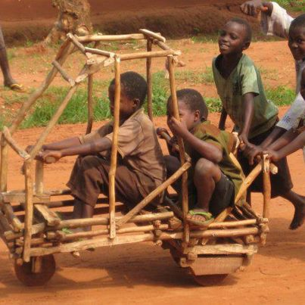

Slide 38
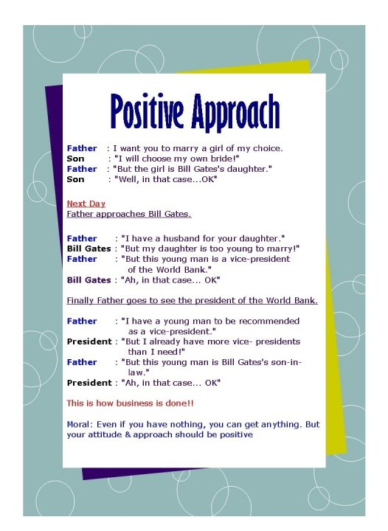

Slide 39
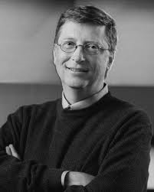
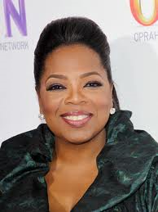
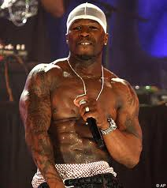
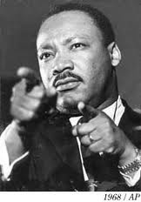



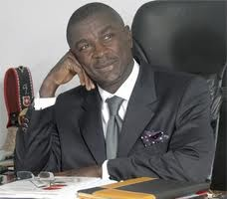

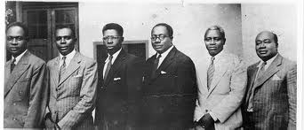
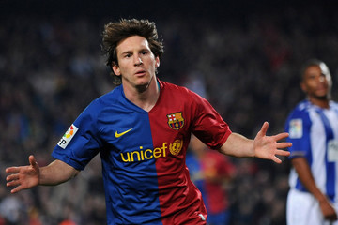


Slide 40
ENTREPRENEURS
"I didn't even complete my University Education"
Bill Gates
"In my childhood days, I stitched shoes"
Abraham Lincoln
"I struggled academically throughout elementary school" - Ben Carson

Slide 41
ENTREPRENEURS cont.
"I used to serve tea at a shop to support my football training" - Lionel Messi
"I used to sleep on the floor in friends' rooms, returning Coke bottles for food money, and getting weekly free meals at a local temple"
Steve Jobs
"My teachers used to call me a failure"
- Tony Blair

Slide 42
ENTREPRENEURS cont.
“I started Living Faith Church from a lawn tennis court with three members only and preached prosperity but today we have the largest church auditorium in the world" – Bishop David Oyedepo
“I was in prison for 27 years and still became president” – Nelson Mandela
“I was on the verge of suicide when an idea of opening a restaurant hit me after I retired as a cook in the navy” – Harland Sanders (Founder of KFC)

Slide 43
ENTREPRENEURS cont.
“I am a son of a black immigrant from Kenya. I graduated from Harvard and later on became a Senator in Chicago. I was also a President of the most powerful nation on earth” – Barack Hussein Obama
“ I worked for my uncle since I was a small boy, people looked down on me. I later took a loan from my uncle to open a tiny shop. I worked hard to make ends meet. Now I am the richest man in Africa” – Aliko Dangote

Slide 44

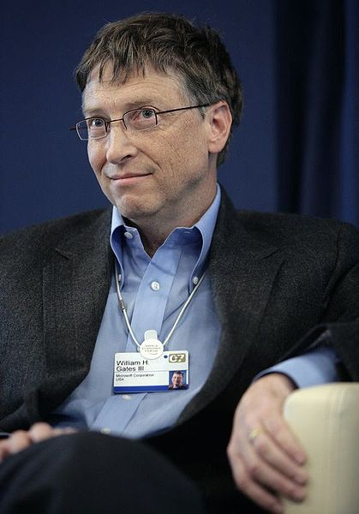
Bill Gates
“It's fine to celebrate success but it is more important to heed the lessons of failure,”
Bill Gates discovered his interest in software and began programming computers at age 13. He is the chief software architect of Microsoft Corporation, the worldwide leader in software, services and solutions that help people and businesses realize their full potential
Net worth $76.0 billion

Slide 45
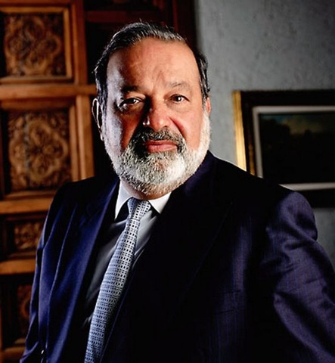
Carlos Slim Helu
Carlos Slim Helu – Telecom $74 billion
First showed a talent for business as a 10-yr old kid when he filled his pockets with pesos selling drinks and snacks to his family members and friends

Slide 46
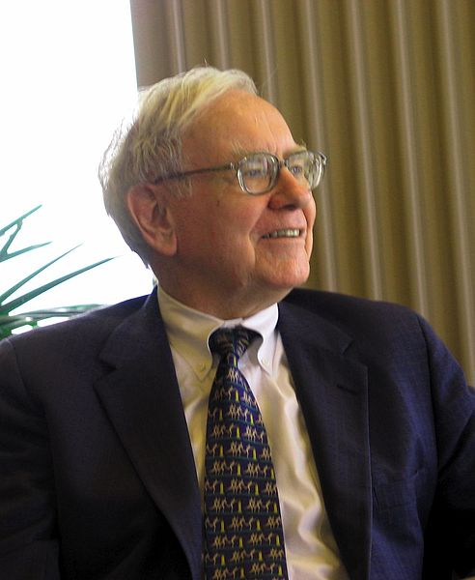

Warren Buffett- 4th Richest
I’m 15 percent Fisher and 85 percent Benjamin Graham. The basic ideas of investing are to look at stocks as business, use the market's fluctuations to your advantage, and seek a margin of safety. That’s what Ben Graham taught us. A hundred years from now they will still be the cornerstones of investing.
He is an American investor, businessman, and philanthropist. He is one of the most successful investors in the world, the primary shareholder and CEO of Berkshire Hathaway
$58.2 billion

Slide 47
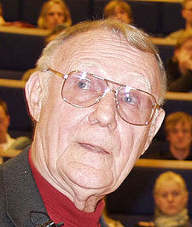
Ingvar Kamprad
Kamprad began to develop a business as a young boy, selling matches to neighbors from his bicycle. He found that he could buy matches in bulk very cheaply from Stockholm, sell them individually at a low price, and still make a good profit.
From matches, he expanded to selling fish, Christmas tree decorations, seeds, and later ballpoint pens and pencils

Slide 48
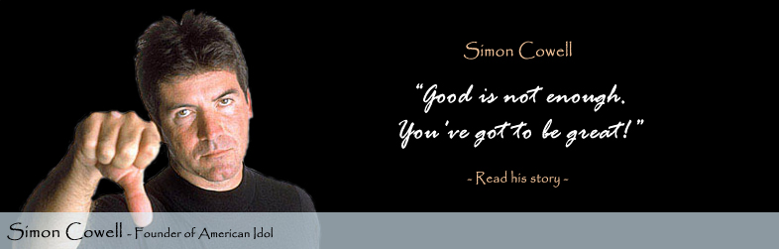
Simon Cowell
In 1979, he got his first job working as a mail room clerk for EMI Music Publishing. “In many ways, I was glad that I had started my career on the very low rung of the business,” Cowell recalls. “It was there that I learned how to deal with people.” Over the next few years, Cowell would work his way up within the ranks of the company to eventually become a record producer. Unsatisfied with his prospects, Cowell left EMI in the early 1980s to form E&S Music, his own independent music company.

Slide 49
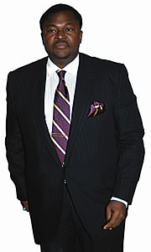
Dr. Mike Adenuga Jnr.
The man Adenuga means different things to different people. A husband, father, team leader, role model, benefactor and an entrepreneur par excellence while some would argue that he is one of the champions of Nigeria’s economic development!
A man of abundant positive energy and immense personal drive, Adenuga still drives himself around town in his choice automobiles even though there are drivers at his beck and call. Adenuga has thus also become a metaphor in modesty
The man Adenuga means different things to different people. A husband, father, team leader, role model, benefactor and an entrepreneur par excellence while some would argue that he is one of the ampions of Nigeria’s economic development!
A man of abundant positive energy and immense personal drive,ty

Slide 50
Life is not about what you couldn't do so far, it's about WHAT YOU STILL CAN! So never give up!....

Slide 51
Theories of Entrepreneurship
Economic Theory
Adam Smith perceived capitalists as owner-managers who combined the basic resources of land, labour, and capital into successful enterprises
Psychological Theory
the myth that some people are genetically predisposed to be entrepreneurs.
In addition, Burch (1986) listed the following traits as typical of entrepreneurs.
Desire to achieve
Desire to work hard for themselves rather than working

Slide 52
Theories of Entrepreneurship
Psychological Theory
According to Rotter’s (1966) work on locus
of control, individuals who are ‘internal’ or
believe that they control their own destiny
are more likely to be entrepreneurs.

Slide 53
Theories of Entrepreneurship
Sociological Theory
The main focus of sociological enterprise is to identify its social context in relation to entrepreneurial opportunity;
(1) social networks,
(2) life course stage,
(3) ethnic identification and
(4) population ecology stage

Slide 54
THE ENTREPRENEURIAL PROCESS (EP)

Slide 55
The Entrepreneurial Process
According to Barringer and Ireland (2006), entrepreneurship is the process by which individuals pursue opportunities without regard to the resources that they currently control.
Thus entrepreneurship can be referred to as the creation of a new organization or new business and answers the question of “what business should we enter?

Slide 56
The Entrepreneurial Process
Deciding to become an entrepreneurs
Developing successful business idea
Moving from an idea to an entrepreneurial firm
Managing and growing the entrepreneurial firm

Slide 57
FACTORS INFLUENCING ENTREPRENEURSHIP
Entrepreneurs as Heroes
Entrepreneurs are raised to hero status and have held out their accomplishments as model to follow. Business founders such as Michael Dell (Dell Inc.) and Kwame Despite( Peace fm) are recognised as role models in their respective societies.

Slide 58
FACTORS INFLUENCING ENTREPRENEURSHIP
Entrepreneurial Education
People with more education are more likely to start businesses than those with less education, and entrepreneurship, in particular, is an extremely popular course of study among students at all levels.
A rapidly growing number of college students see owing a business as an attractive career option, and
In addition to signing up for entrepreneurship courses, many of them are launching companies while in school.

Slide 59
FACTORS INFLUENCING ENTREPRENEURSHIP cont.
Shift to a Service Economy
The cost of establishing a service company is relatively low as compared to manufacturing.
The booming service sector has provided entrepreneurs with many business opportunities.

Slide 60
FACTORS INFLUENCING ENTREPRENEURSHIP cont.
Technology Advancement
Small to large scale enterprises depend on computers to help them with their business needs.
Ranging from
Point of Sales systems,
information management systems capable of handling all kinds of information such as employee profile, client profile, accounting and tracking, automation systems for use in large scale production of commodities, package sorting, assembly lines, all the way to marketing and communications.

Slide 61
FACTORS INHIBITING ENTREPRENEURSHIP
Uncertainty of Income
Opening and running a business provides no guarantees that an entrepreneur will earn enough money to survive.
Some small businesses barely earn enough to provide the owner-manager with adequate income.
In the early days of a start-up, a business often cannot provide an attractive salary for its owner.

Slide 62
FACTORS INHIBITING ENTREPRENEURSHIP Con’t
Risk of Losing Your Entire Invested Capital
The small business failure rate is relatively high.
A failed business can be financially and emotionally devastating.
They should consider the risk/reward trade-off before putting their personal assets and their mental well-being at risk.

Slide 63
FACTORS INHIBITING ENTREPRENEURSHIP Con’t
Long Hours and Hard Work
Most business owners do everything themselves, owners experience intense, draining workdays.
People who work an average of 11 or more hours per day have a 67 percent higher risk of suffering a heart attack or dying from heart disease than people who work a standard seven- to eight-hour day, according to a new study in the Annals of Internal Medicine.

Slide 64
FACTORS INHIBITING ENTREPRENEURSHIP Con’t
Discouragement
Launching a business requires much dedication, discipline and tenacity.
Discouragement and disillusionment can set in but successful entrepreneurs know that every business encourage rough spots.
And that perseverance is required to get through them.

Slide 65
TYPES OF ENTREPRENEURS
Entrepreneurs can be classified on the basis of:
Type of business
Use of Technology
Motivation
Growth
Stages in Development

Slide 66
TYPE OF BUSINESS
Business entrepreneur:
Convert ideas into reality; deal with both manufacturing and trading aspect of business (Small trading and manufacturing business)
Trading entrepreneur:
Undertakes trading activities; concerned with marketing (Domestic and international level).
Industrial entrepreneur:
Undertakes manufacturing activities only; new product development etc (textile, electronics, etc)

Slide 67
TYPE OF BUSINESS Cont.
Corporate entrepreneur:
Interested in management part of organisation; exceptional organizing, coordinating skills to manage a corporate undertaking
Agricultural entrepreneur:
Production and marketing of agricultural inputs and outputs.

Slide 68
USE OF TECHNOLOGY
Technical entrepreneur:
Production oriented, possesses innovative skills in manufacturing, quality control etc.
Non technical entrepreneur:
Develops marketing, distribution facilities and strategies
Professional entrepreneur:
Uses the proceeds from sale of one business to start another one. Brimming with ideas to start new ventures

Slide 69
MOTIVATION
Pure entrepreneur:
Psychological and economic rewards motivate him
Induced entrepreneur:
Incentives, concessions, benefits offered by government for entrepreneurs motivates him
Motivated entrepreneur:
Sense of achievement and fulfillment motivate him
Spontaneous entrepreneur:
Born entrepreneurs with inborn traits of confidence, vision, initiative

Slide 70
Growth
Growth entrepreneur:
- One who enters a sector with a high growth rate; is a
positive thinker
Super growth entrepreneur:
- One who enters a business and shows a quick, steep and upward growth curve

Slide 71
STAGES IN DEVELOPMENT
First generation entrepreneur:
Innovator, risk taker, among the firsts in family to enter business
Modern entrepreneur:
Who considers feasibility of business, which can adapt to change and dynamic market
Classical entrepreneur:
One who gives more importance to consistent returns than to growth; concerned about customer and marketing needs

Slide 72
PERSONALITY TRAITS ALL ENTREPRENEURS MUST HAVE
1. The need for Autonomy
Entrepreneurs see a job as a form of economic slavery and prefer to have personal autonomy to economic security.
The worst part about being your own boss is that the expectations for your job function are set higher than for everyone else.
The best part about being your own boss is that if you don’t like your orders, you can change them anytime you please.

Slide 73
PERSONALITY TRAITS ALL ENTREPRENEURS MUST HAVE cont.
2. Decisiveness
The ability to make decisions, sometimes quickly, is a key component of the entrepreneurial personality.
This willingness to make, and hold to, a decision is a necessary leadership skill.

Slide 74
PERSONALITY TRAITS ALL ENTREPRENEURS MUST HAVE cont.
3. The ability to adapt to changing circumstances
Rather than resisting or resenting change, entrepreneurs have the ability to easily adapt to changing circumstances and conditions.
In fact, many entrepreneurs thrive on change. On the negative side, some are so thrilled by change that they will force it, even when things are going perfectly.

Slide 75
PERSONALITY TRAITS ALL ENTREPRENEURS MUST HAVE cont.
4. An intense drive to succeed.
A powerful drive to create success, wealth, legacy or fame is the primary motivator for most entrepreneurs.
They are intensely passionate about what they do, almost to the point of fanaticism.
Their goals are set high and when attained, are reset even higher. Money is not usually sought for its own sake, but as way of keeping score.

Slide 76
PERSONALITY TRAITS ALL ENTREPRENEURS MUST HAVE cont.
5. Energy
Entrepreneurs are energetic. They put in more work hours than most people. They also often play hard and competitively.
They are usually too busy working or playing to be spectators. This high personal energy level translates as constant enthusiasm and personal charisma.

Slide 77
PERSONALITY TRAITS ALL ENTREPRENEURS MUST HAVE cont.
6. A sense of personal destiny
Most entrepreneurs have more than just a strong desire to mold their personal destiny; they have a strong belief in their ability to create their own destiny by their own choices and actions.
If they are among the few who believe in a set fate or predetermined destiny, they believe that they are fated or destined to be successful.

Slide 78
PERSONALITY TRAITS ALL ENTREPRENEURS MUST HAVE cont.
7. A highly developed intuition.
Most entrepreneurs rely more on gut feelings to make decisions than they do on conscious analysis of a situation.
Even though they may be highly analytical and like to accumulate lots of data, their actual decisions are usually based on what feels right.

Slide 79
PERSONALITY TRAITS ALL ENTREPRENEURS MUST HAVE cont.
8. Opportunity seeking.
The true entrepreneur is always on the lookout for yet another new opportunity. It is often just a matter of perspective.
There is the famous story (usually attributed to Joseph Bata) about the shoe company who sends an employee to a country in Africa to ascertain if there is a market for their shoes. The representative reports back, “There is no shoe market here. These people don’t even wear shoes.”
The boss, on hearing this news, exclaims, “This is wonderful. No one has any shoes yet. What a huge opportunity!”

Slide 80
PERSONALITY TRAITS ALL ENTREPRENEURS MUST HAVE cont.
9. Perseverance and determination
The obstacles that cause many people to quit are minor setbacks for the true entrepreneur. Winners persist. Losers desist.
It is often that simple personality difference that separates the happy successful person from the frustrated failure.

Slide 81
PERSONALITY TRAITS ALL ENTREPRENEURS MUST HAVE cont.
10. Problem solving.
When others focus on existing problems, entrepreneurs focus on possible solutions. There is always a solution. There is always a problem.
For most people, a problem is an impediment. For the entrepreneur, a problem is an opportunity to discover or create a better solution.

Slide 82
PERSONALITY TRAITS ALL ENTREPRENEURS MUST HAVE cont.
11. A desire for personal growth.
Entrepreneurs are learners and self-improvers.
They are always on the lookout for ways to get the competitive edge, to become better at doing what they do, to develop new skill sets or understandings.
They understand that what you have depends upon what you do and what you are able to do depends upon who you are. They work constantly to become more.

Slide 83
CHARACTERISTICS OF SUCCESSFUL ENTREPRENEURS
1. Have a Unique Perspective on Risk.
Successful entrepreneurs don’t take no for an answer and they don’t fear failure.
They don’t view risk the same way ordinary people do, which allows these entrepreneurs the psychological freedom to explore opportunities that would scare most conventional business thinkers.

Slide 84
Con’t
2. Communicate Vision and Instill Passion.
Great entrepreneurs must be able to move an idea to reality in order to be successful.
Accomplishing this requires working through others.
Entrepreneurs must create and communicate their vision in a way that generates enthusiasm and inspires action.

Slide 85
Con’t
3. Demonstrate Resilience and Rapid Recovery.
Entrepreneurs who thrive accept the potential for failure and embrace failure when it happens. The root of their strength is that they don’t necessarily see themselves or their partners as failures.
Their focus is on learning and adjusting as opposed to wallowing in self-pity or seeking out scapegoats.
They always find a way to get back on track quickly, which means they have little time for playing the blame game.

Slide 86
Con’t
4. Do What They Do Best.
Top entrepreneurs stick to their core competencies and outsource the rest.
The ability to identify and then let go that which is outside the scope of their expertise is what enables these entrepreneurs to rapidly grow their organizations.
Scalability has always been fundamental to taking a start-up and building it into a successful enterprise. Creating scalability starts with selecting and hiring the right people.

Slide 87
Con’t
5. Preserve What They Build.
For many entrepreneurs, founding a business is like creating a child.
It’s a labor of love that they have a strong personal investment in.
Personal attachment is often why founders like Steve Jobs and Howard Schultz return to the businesses they started during turbulent times.

Slide 88
REASONS WHY PEOPLE BECOME ENTREPRENEUR
1. Satisfaction
Helping other people and improving other people’s lives is quite satisfying.
In fact, entrepreneurs experience much personal satisfaction through helping other people.
Often, their new venture is beneficial to others, and it meets other people’s needs through services and products offered.

Slide 89
cont.
2. Independence
Getting to work on your own is one of the best reasons to become an entrepreneur.
Being the boss, you get to call the shots. An entrepreneur can set his own schedule; can work regular hours.
An entrepreneur can manage their own business independently and can have quality time with their family anytime they want.

Slide 90
Cont.
3. Feeling of Pride
An entrepreneur’s job always accompanies sacrifices.
An entrepreneur is rewarded with a feeling of pride when they give everything to succeed.

Slide 91
Cont.
4. Building Relationships
You can have the opportunity of meeting new people and build new relationships.
You will have a greater chance of meeting other people who have been in similar situations.
Your circle of friends and acquaintances will grow by sharing tips and asking for advice as well as partnering with other business owners.

Slide 92
Cont.
5. Job Security
If you own your business, you are the boss and you won’t get fired.
Being the boss, you are responsible for the lives of many people
It motivates you to be at your best at all times.

Slide 93
Cont.
6. Income Potential
You can generate your own income level when you own your own business.
You can reward yourself with more money if you work hard, work smart and work longer hours.
A potential income can keep you motivated to do your best.

Slide 94
ENTREPRENEUR FUNCTIONS
Risk takers
Fund Raisers
Project Planners
Product Analysists
Business Decision-makers
Feasibility Analysists
Analysists of assessment of risk
Organization and Management Experts
Employers

Slide 95
THE CORRIDOR PRINCIPLE
The Corridor Principle states, that with every venture launched, new and unintended opportunities often arise.

Slide 96
TRUE OR FALSE. Explain.
Starting and operating a small business is all that entrepreneurship is about.

